Slide 1
Qiskit’s VQE
Calculating the ground state of a Quantum Harmonic Oscillator and small perturbations.
Notes:
Presentation by Marco Antonio Barroca
This work was based on a previous project from 2020 that relied on Qiskit as well as Wolfram Mathematica. It was updated to work with the most recent release of Qiskit and expanded to include the study of small perturbations of the harmonic oscillator (anharmonic oscillators).
In this version Mathematica is no longer required.

Slide 2
Contents
Variational Quantum Eigensolver
Mapping the Hamiltonian
Variational Forms
Simulations
Real Device
Notes:
This is a simple index of what will be discussed in the presentation.
We shall first discuss what the VQE is, then how to build our problem for the algorithm and finally present our results after running the algorithm in simulations and real devices

Slide 3
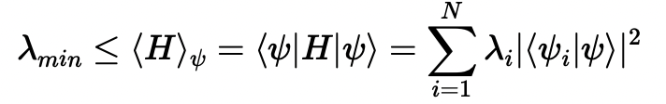
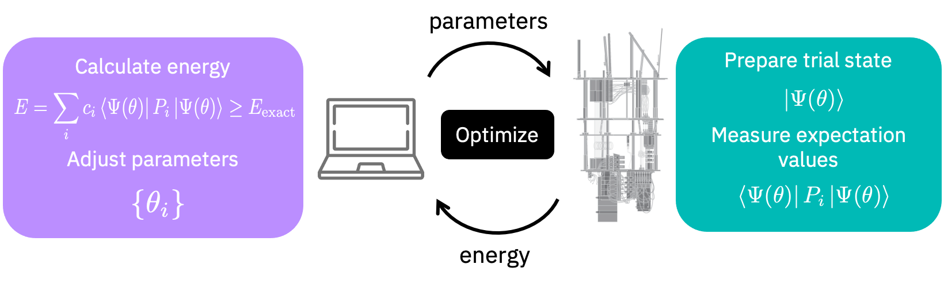
Variational Quantum Eigensolver
Calculates the ground state energy via the variational principle.
Hybrid classical and quantum algorithm.
Image taken from https://qiskit.org/documentation/nature/tutorials/03_ground_state_solvers.html
Notes:
The algorithm requires the use of a classical computer.
We provide an initial guess of a parametrized quantum state, the quantum computer prepares the state and calculates the expectation value, the classical computer then updates the wave function to run another iteration based on the calculated expectation value.
We can reach a lower bound for the expectation values after multiple iterations. This should be the ground state energy.

Slide 4
Variational Quantum Eigensolver
We require three things in order to run a VQE problem on a quantum computer:
A Hamiltonian mapped to a qubit system written as a Pauli operator weighted sum.
A parametrized quantum state that can be systematically varied. We’ll call it a Variational Form.
An optimizer that will ensure minimization of expectation values. Qiskit already provides them.
On noisy environments it is recommended to use the SPSA (Simultaneous Perturbation Stochastic Approximation) optimizer. Less circuit evaluations required due to simultaneous perturbations.
On ideal simulations we have multiple options such as COBYLA (Constrained Optimization by Linear Approximation) or SLSQP (Sequential Least SQuares Programming). Normal gradient descent method.
Notes:
Optimization works by varying each parameter in the direction which opposes the gradient in order to find a local minimum. This is called gradient descent.
SPSA works by estimating the gradient of the objective function by simultaneously perturbing every parameter randomly and then evaluating the result of the expectation value. The idea is that as every parameter is being shifted, shifts due to noise are less relevant. noise gets “absorbed” into the process. This is also relevant as iterations do not increase with the number of parameters, which means less circuit evaluations.
Other optimizers such SLSQP will only vary one parameter at a time which means an increase in the number of iterations as the number of parameters grow. The exception to this rule is COBYLA making it ideal to reduce the number of iterations on non-noisy environments

Slide 5
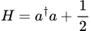
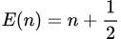
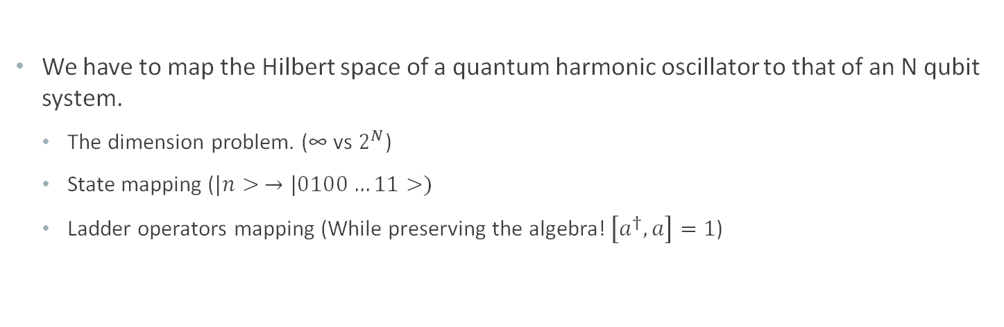
Mapping the Hamiltonian
We have to map the Hilbert space of a quantum harmonic oscillator to that of an N qubit system.
The dimension problem. (∞ vs $2^{N}$)
State mapping ($|n> →\text{|0100}…11>)$
Ladder operators mapping (While preserving the algebra! $\left[a^{†},a\right]=1$)
Notes:
Note that in usual applications of the VQE, molecular Hamiltonians are mapped via Jordan Wigner mapping or alternatives such as parity mapping. Such options are already integrated into Qiskit.
In our problem we must figure out how to realize the mapping of our system.

Slide 6
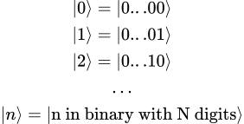
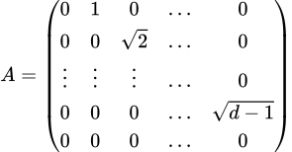
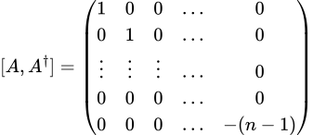
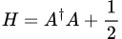
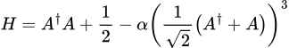
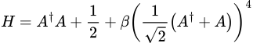
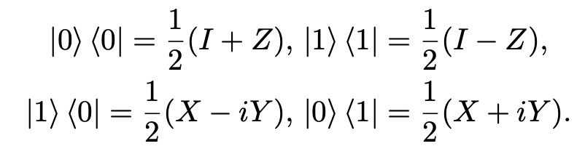
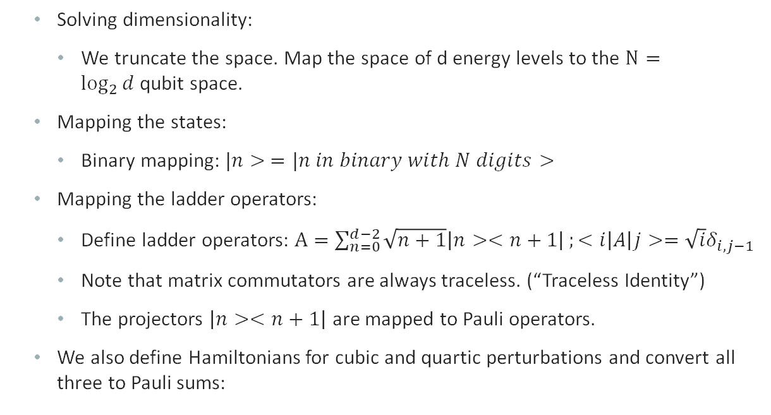
Mapping the Hamiltonian
Solving dimensionality:
We truncate the space. Map the space of d energy levels to the $N=\log_{2}{d}$qubit space.
Mapping the states:
Binary mapping: $|n> =|n in binary with N digits>$
Mapping the ladder operators:
Define ladder operators: $A=\sum_{n=0}^{d−2}{\sqrt{n+1}\left|n><n+1\right|};<i\left|A\right|j>=\sqrt{i}δ_{i,j−1}$
Note that matrix commutators are always traceless. (“Traceless Identity”)
The projectors $\left|n><n+1\right|$ are mapped to Pauli operators.
We also define Hamiltonians for cubic and quartic perturbations and convert all three to Pauli sums:
Notes:
Converting Qiskit operators to Pauli Sums has become a lot easier recently. In a previous version of this project this had to be done manually on Wolfram Mathematica and imported into Qiskit, presently we can just call Qiskit functions.
It’s important to note that these truncated Hamiltonians do not have the same spectrum as the complete ones, fortunately they agree at the ground state which should be enough as we are only interested in the ground state energy. This is only true for small perturbations as well.
Further information on this can be found in the articles mentioned at the end of the presentation.

Slide 7
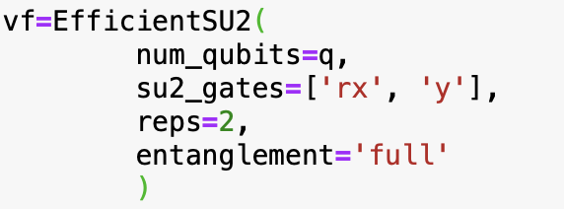
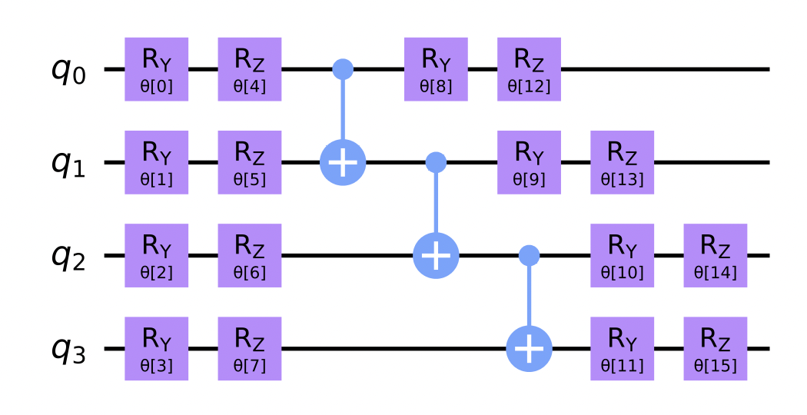
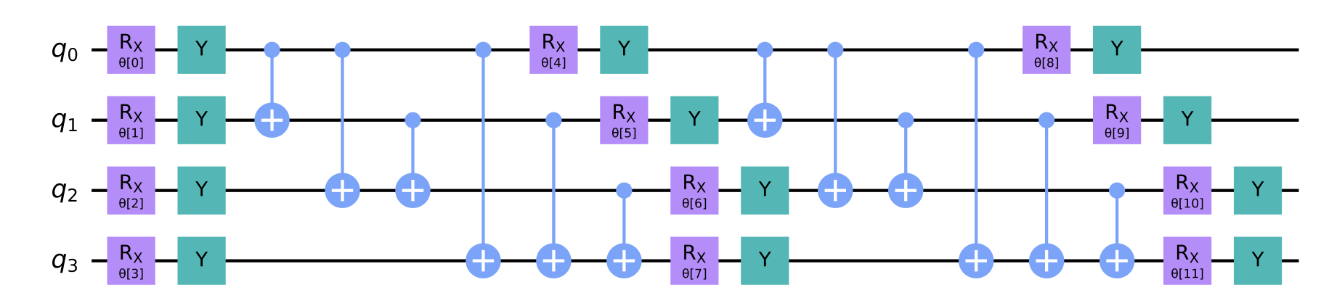
Variational Forms
Variational Forms are fixed form parametrized circuits that will be applied to the state |0>
Qiskit provides a multitude of ways to create parametrized circuits, we shall focus on the EfficientSU2 method.
Hardware Efficient.
Alternating layers of SU(2) (mostly rotations) and entangling (mostly CNOTs) operations.
Real devices: Low repetitions and linear entanglement.
Lower depth = Less errors
Linear entanglement = No SWAP Gates.
Notes:
Hardware efficient: The recommended way to generate variational forms that will run on noisy environments.
Qiskit allows us to customize the variational form, we can define the number of qubits, which gates to use, the type of entanglement between the qubits, number of repetitions.
We want low repetitions for lower depth circuits and IBM computers usually prefer linear entanglements. Non-adjacent qubits aren’t directly connected, full entanglement would require SWAP gates to entangle non adjacent qubits increasing depth.

Slide 8
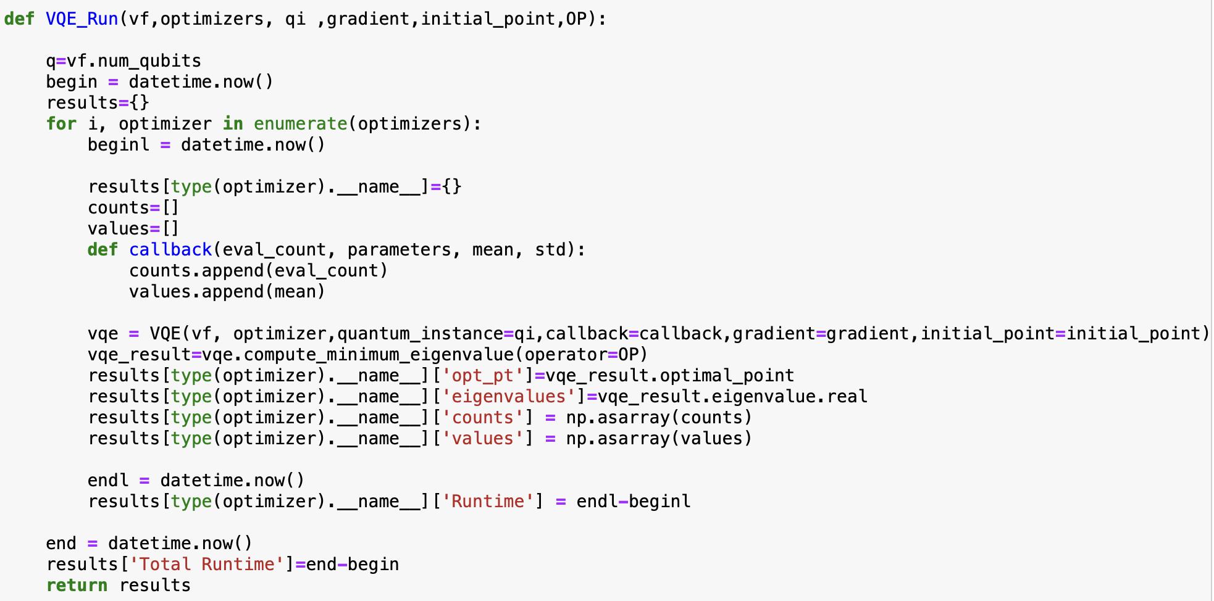
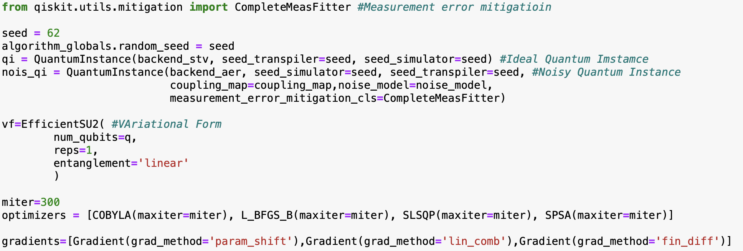
Simulations
We can now begin doing VQE calculations in Qiskit.
We run both ideal and noisy simulations in different optimizers.
The noise model of our simulations is based on the IBM Manila quantum computer
Note we can also provide an initial point to our Variational Form.
Notes:
The function on the right executes the VQE algorithm while below we have set the initial parameters for the experiment such as the variational form, optimizer and quantum instance (responsible for simulation parameters such as the noise model)
Being able to provide an initial point to the variational form is interesting because we can use results from similar problems to facilitate the calculations in more complex problems.
In our case we can use the harmonic oscillator results as an initial point for the anharmonic oscillators.

Slide 9
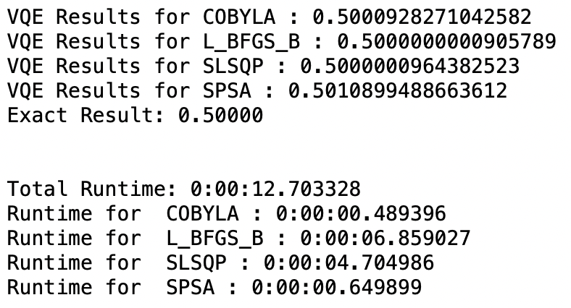
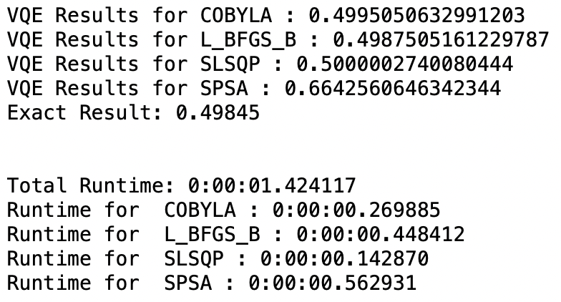
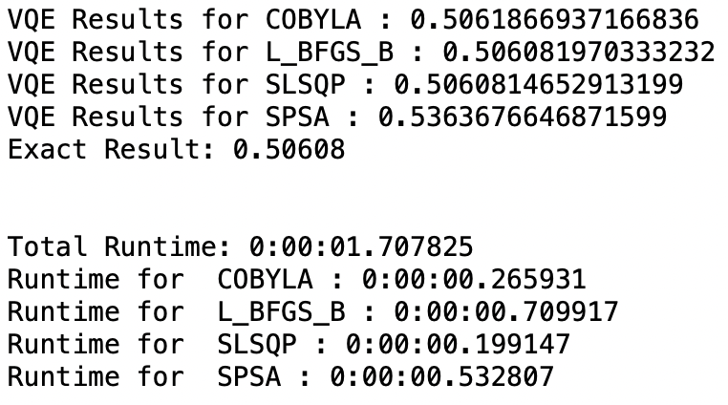
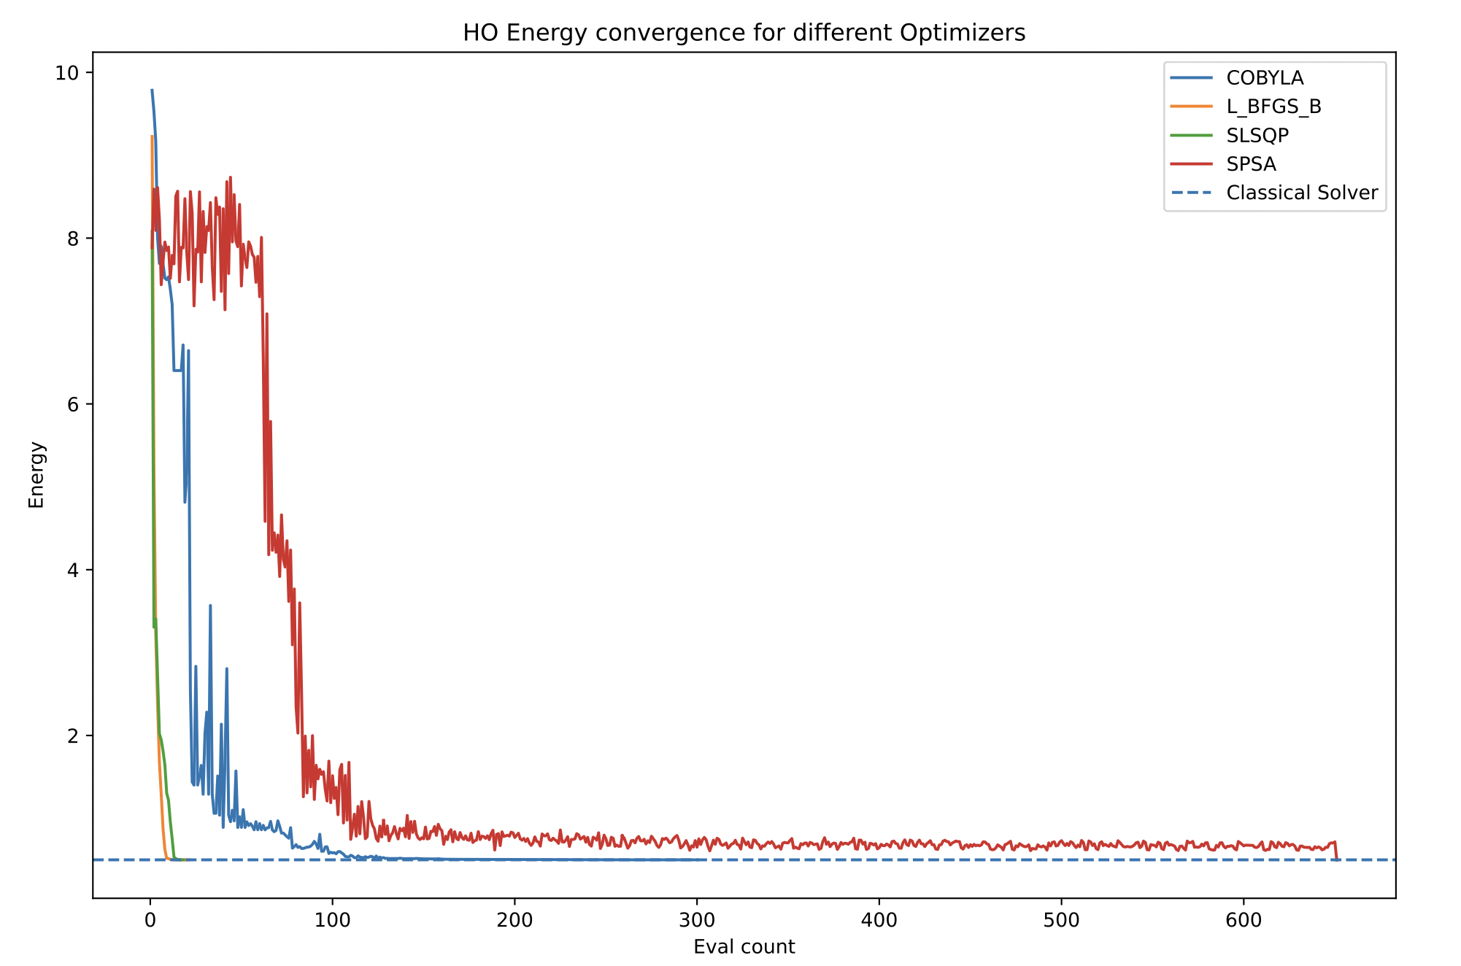
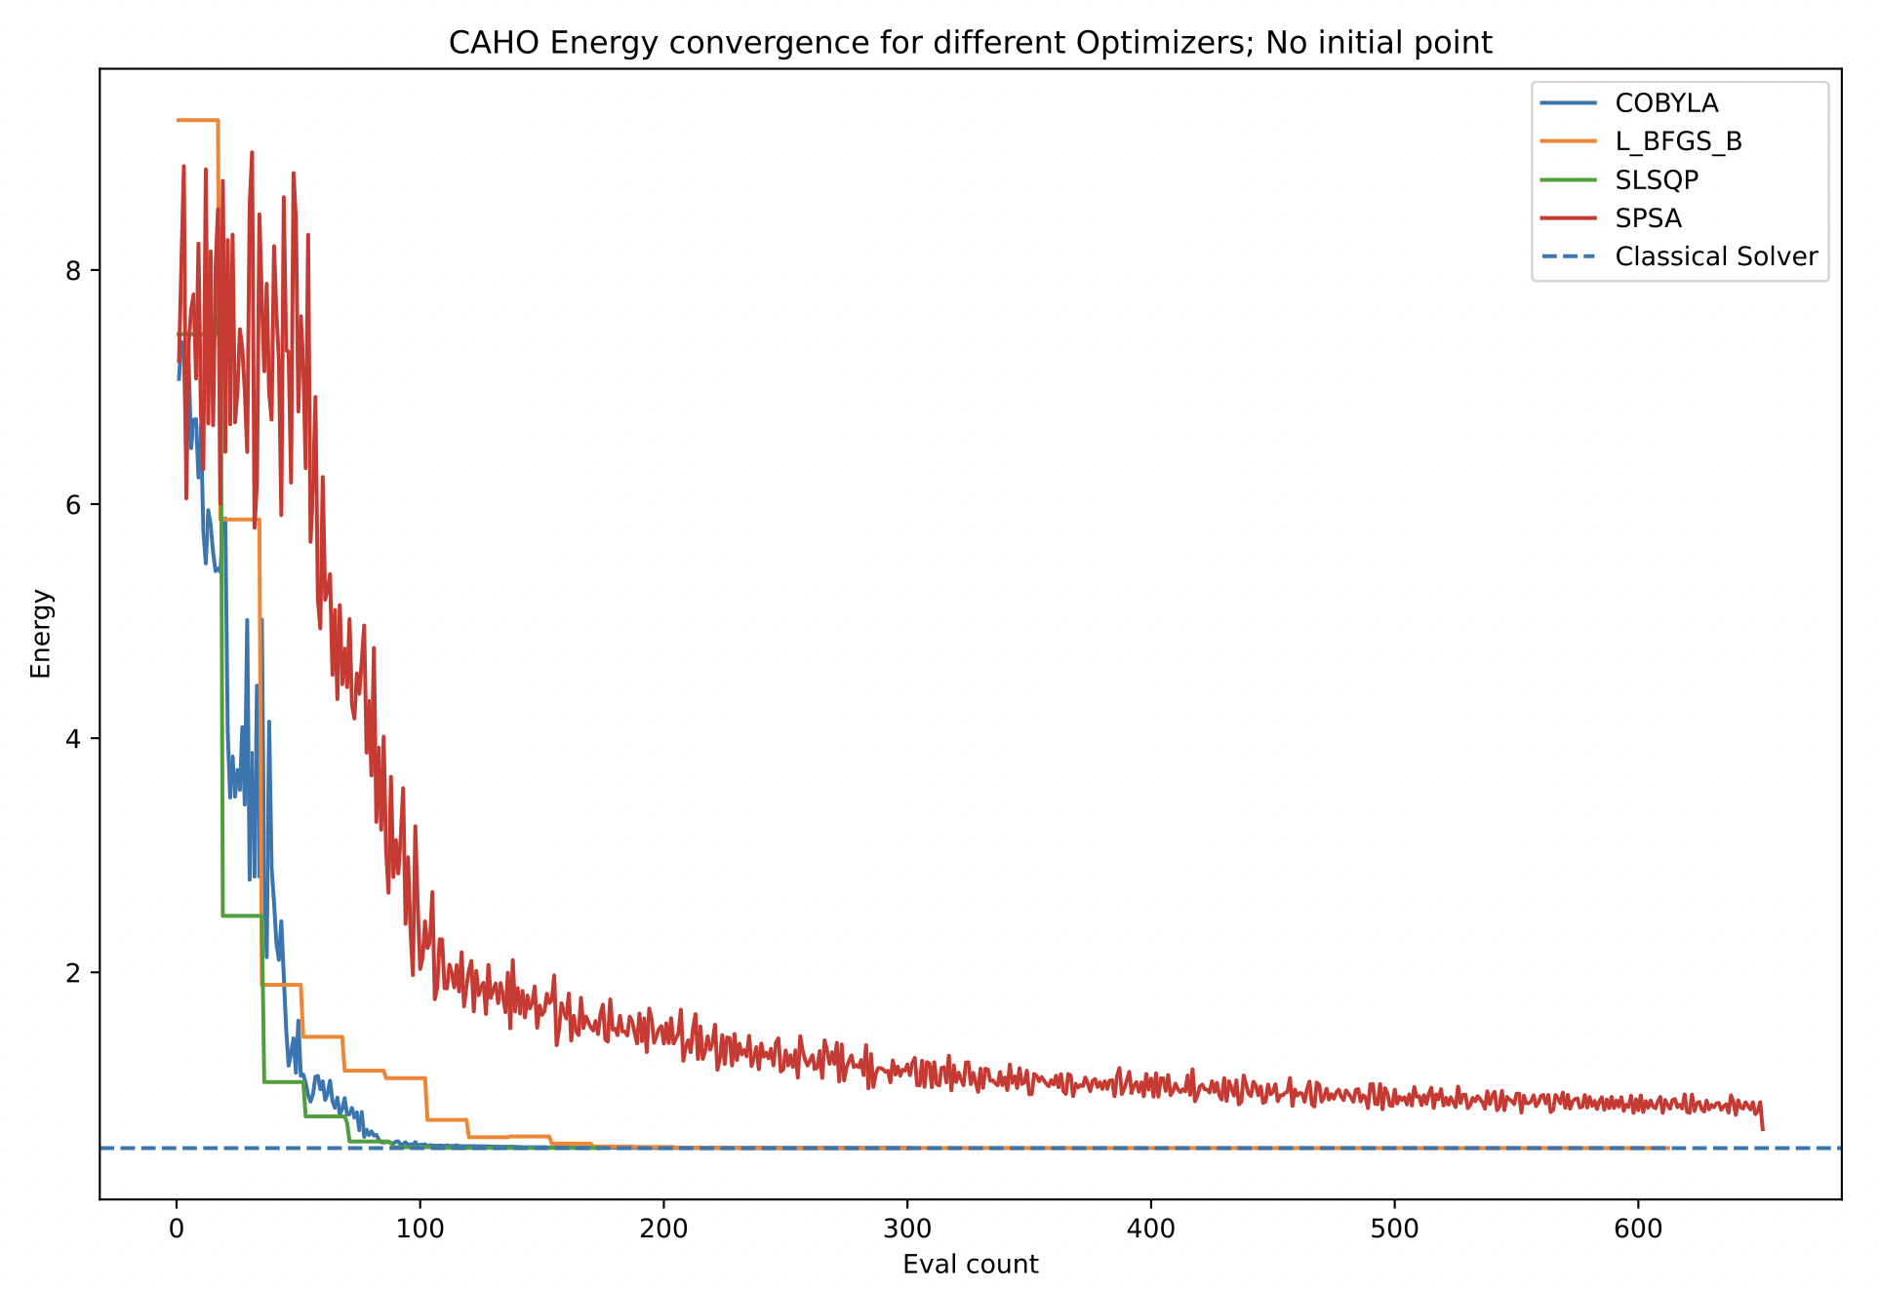
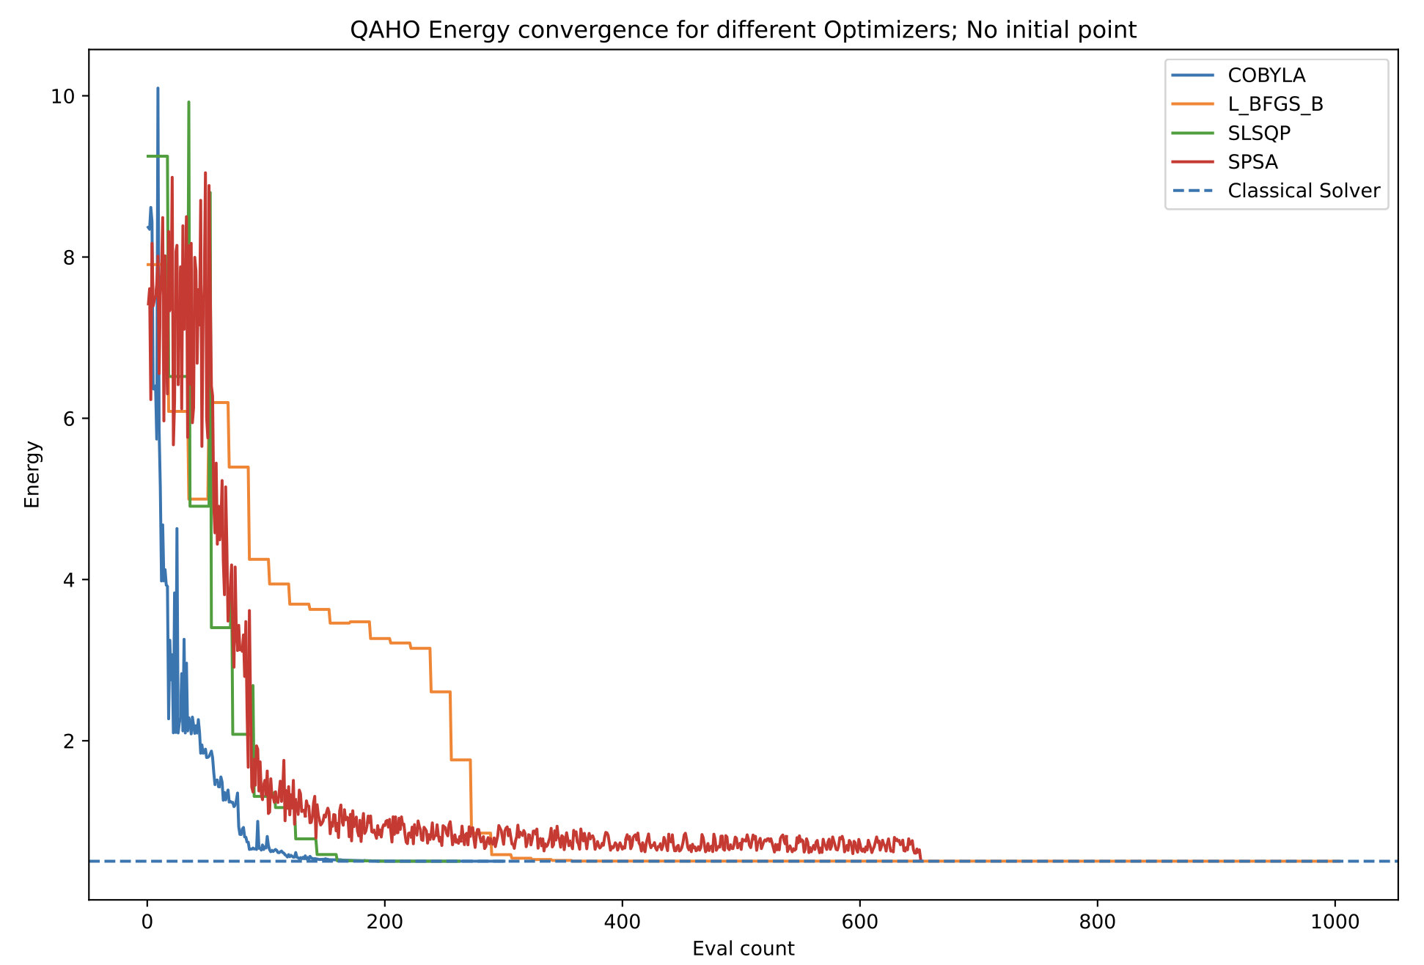
Ideal Simulations
Harmonic Oscillator
Quartic anharmonic Oscillator
Cubic anharmonic Oscillator
Notes:
Note that these simulations were done for small perturbations (coupling g=0.2) as we mentioned before our model falls apart for larger perturbations.
SPSA is not the best for ideal simulations, taking longer and providing worse results.
The best optimizer seems to be L_BFGS_B (Limited-memory Broyden-Fletcher-Goldfarb-Shanno Bound) in the case of ideal simulation, although, with exception of SPSA, all the optimizers seem to give satisfactory results.
There was no need to provide an optimal initial point for the anharmonic oscillators.

Slide 10
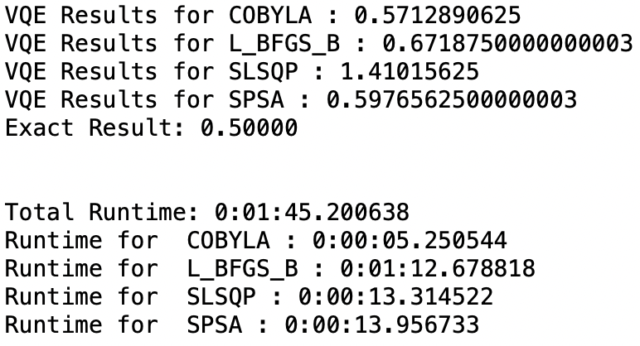
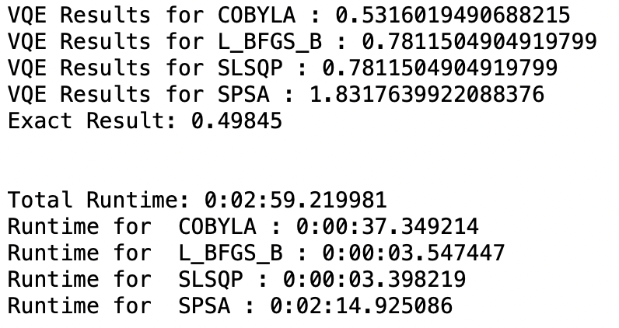
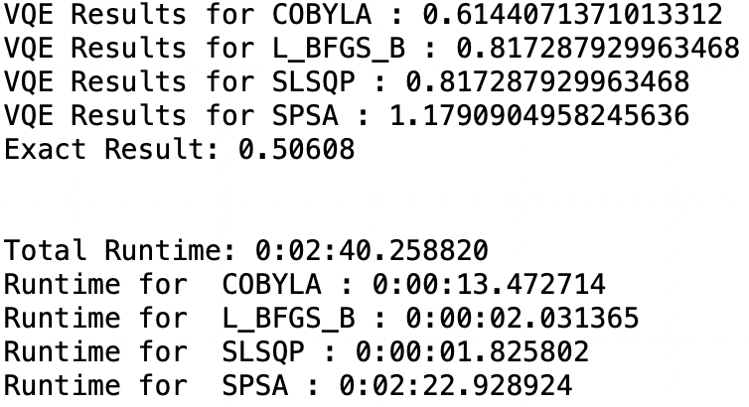
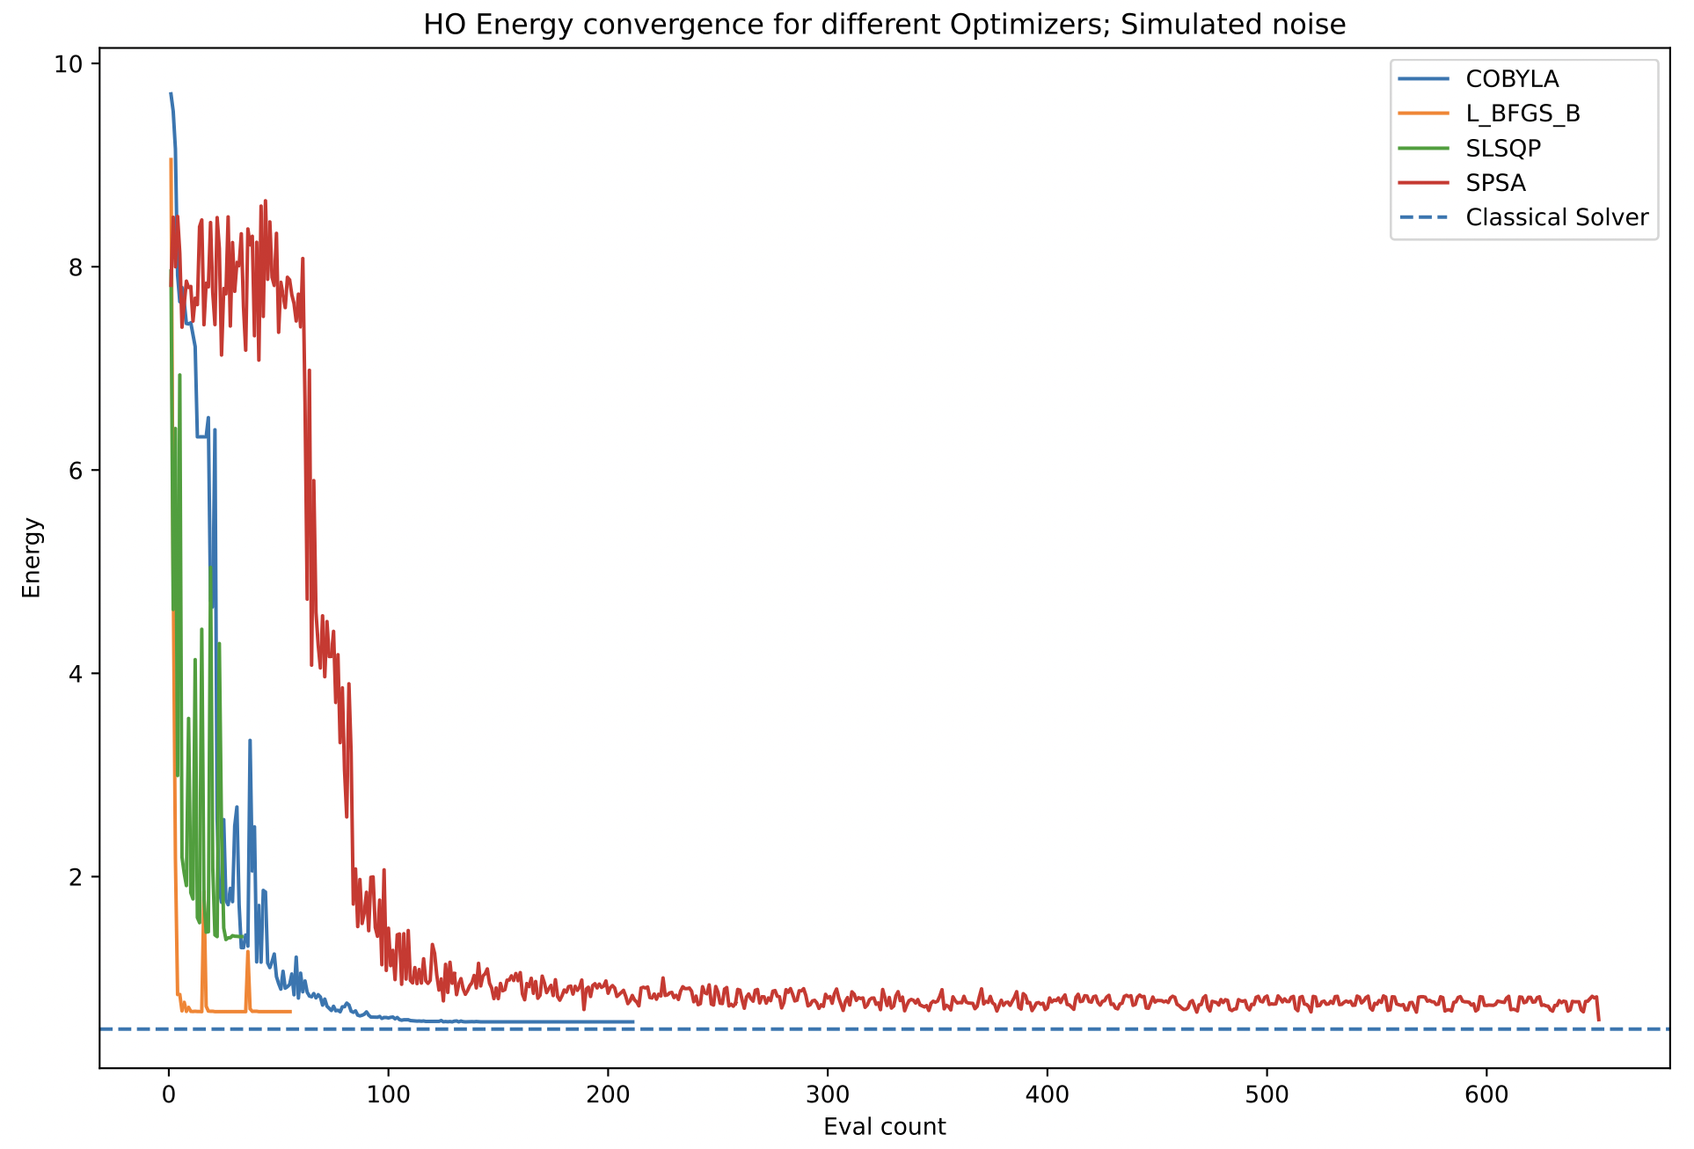
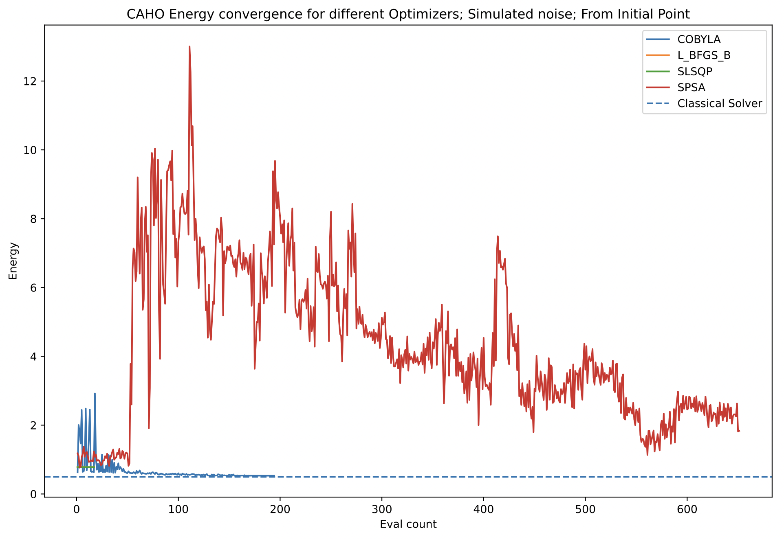
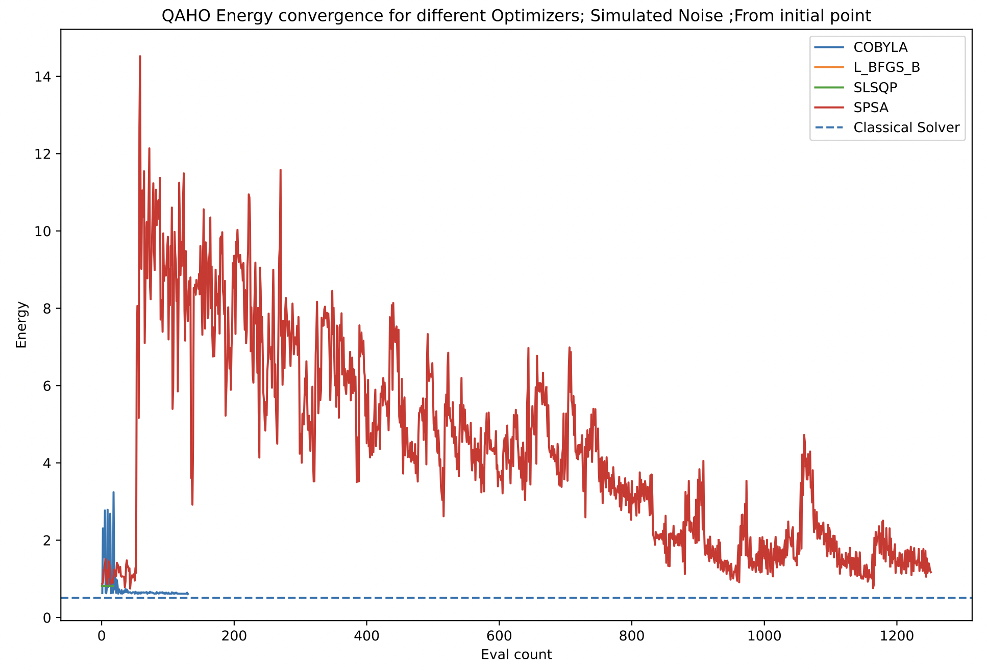
Noisy Simulations
Harmonic Oscillator
Cubic anharmonic Oscillator
Quartic anharmonic Oscillator
Notes:
As the noise predictably leads to worse results, we utilize a new strategy. In here we also use the parameters for the best result in the harmonic oscillator as the initial point of the variational form for the anharmonic oscillators.
SPSA results get considerably worse, but as we have improvements with the other three optimizers, we prefer this result. It’s also worth noting that computation times decreased for all optimizers.
COBYLA now provides us with the best results. We might consider using it on a real device to see if this still holds in reality.

Slide 11
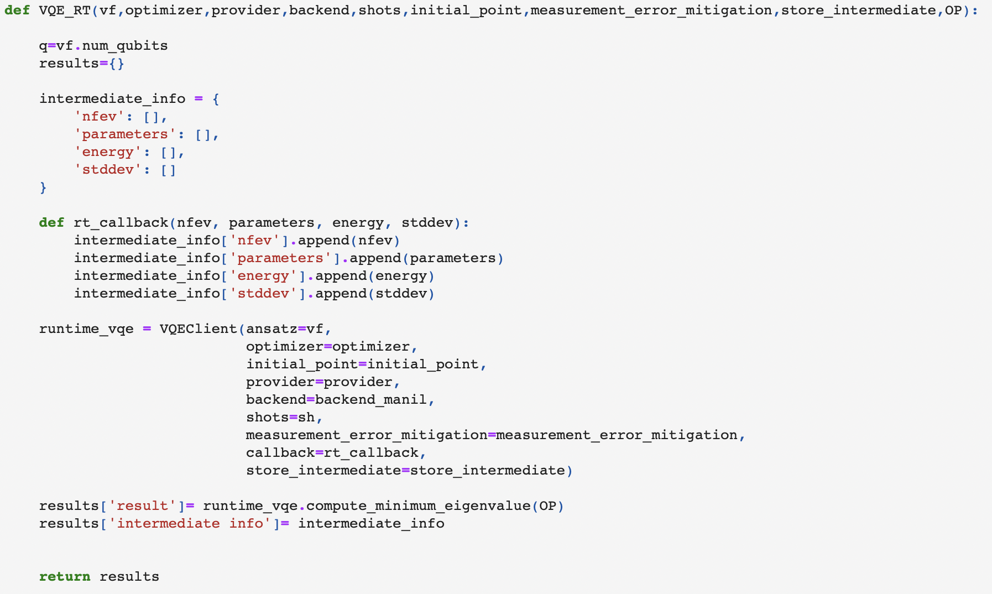
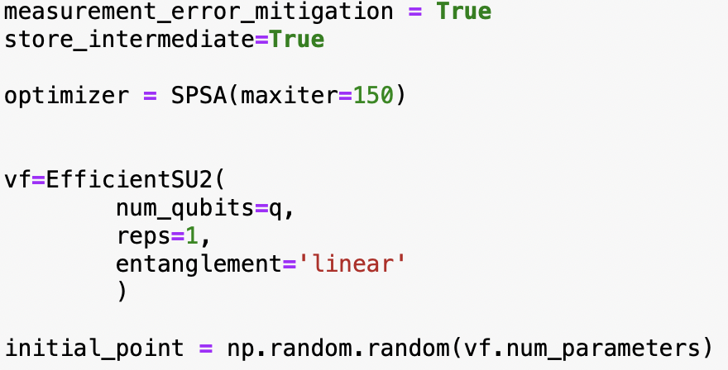
Real devices
The goal now is to use real devices. Specifically IBMQ_Manila
Done with Qiskit Runtime in order to speed up the calculations.
Multiple runs were done, only the best ones are displayed here.
Notes:
Again, we’ll use the results of the harmonic oscillator as an initial point for the other two.
It’s worth mentioning Qiskit Runtime before the results as it’s recently released and essential to running this on real quantum computers.
Note that we won’t display the COBYLA results in this presentation. Suffice to say that they were unsatisfactory.

Slide 12
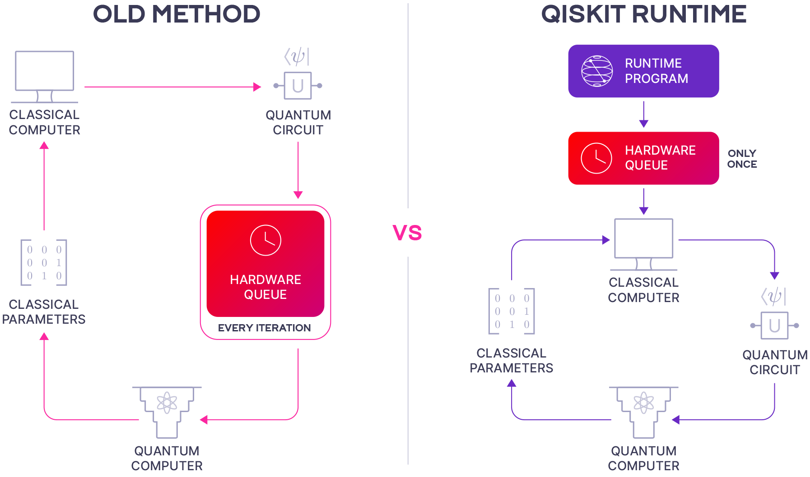
Qiskit Runtime
Released to the general public at the beginning of the year.
Calculations that rely on multiple iterations, specially those of hybrid algorithms, get a considerable boost in computation time.
No longer required to re-enter queue after each iteration.
Image taken from: https://quantumcomputing.com/strangeworks/qiskit-runtime
Notes:
Previously circuit evaluations would have to re-enter at the back of the queue after every iteration as optimization would take place locally.
With Qiskit runtime this is no longer necessary as the calculation is sent to the cloud as a container so it can be run in a classical computer closer to the quantum computer.

Slide 13
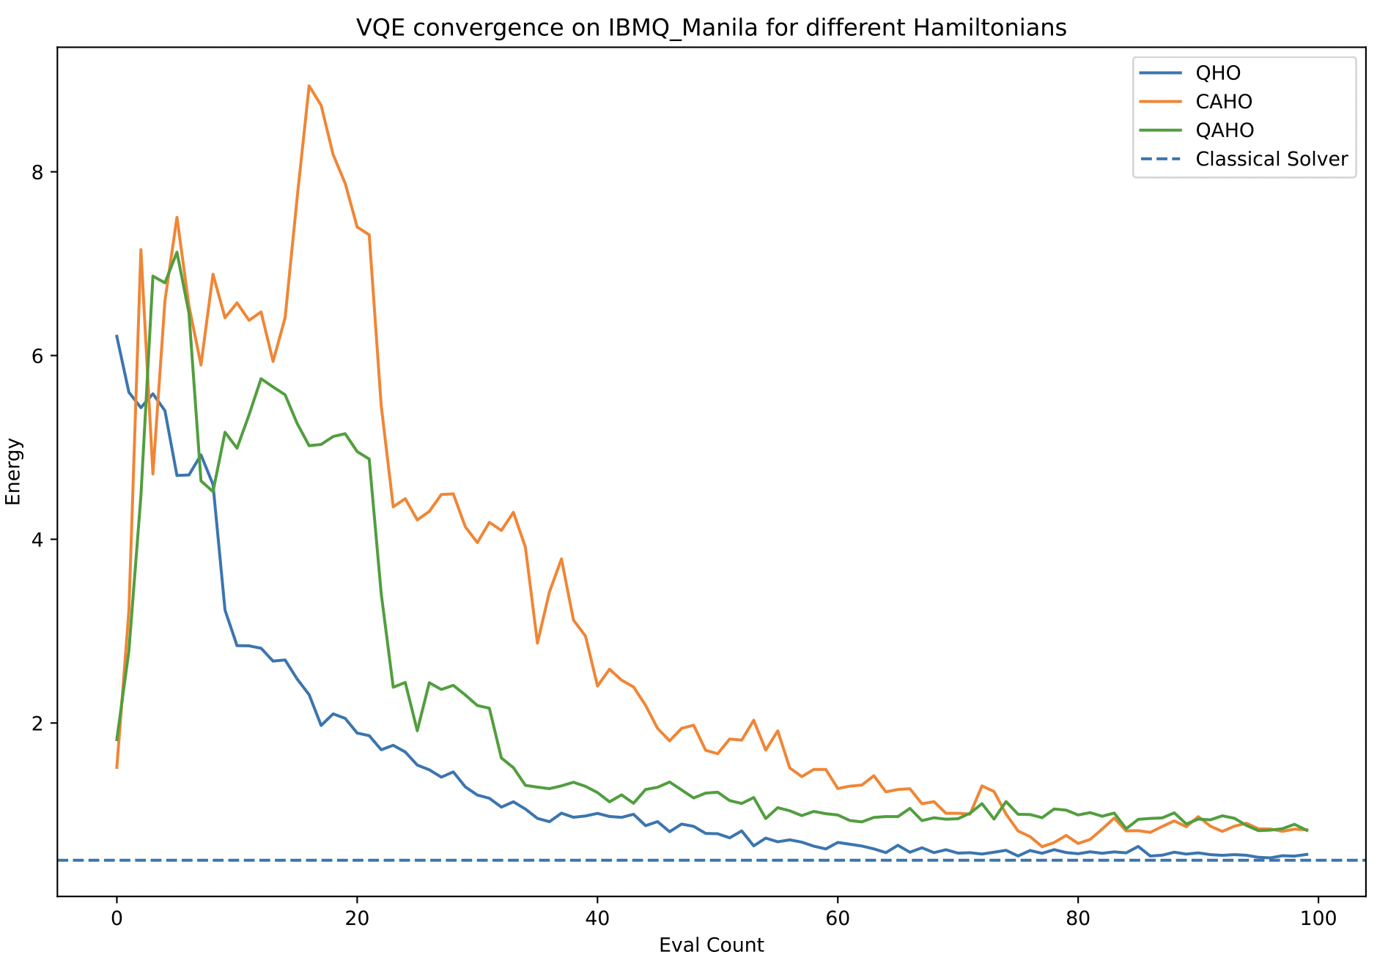
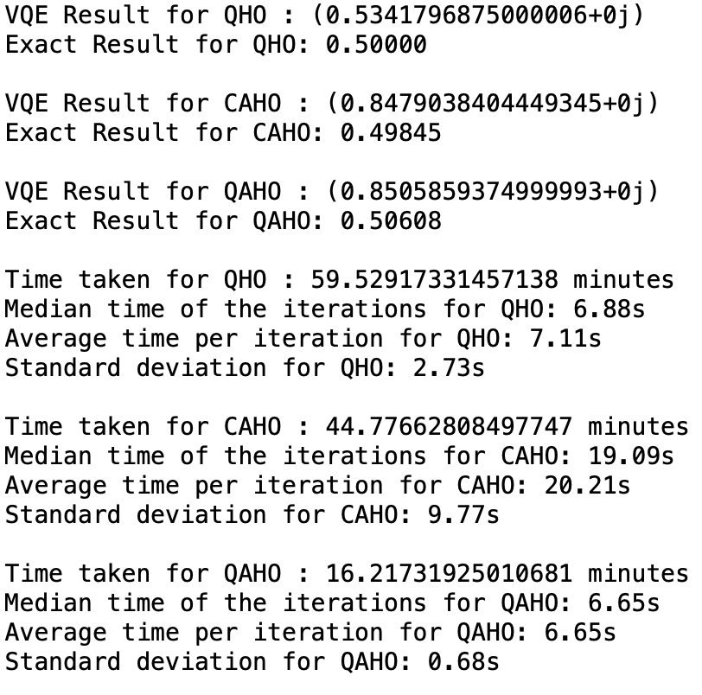
Real Device
Notes:
Previously (circa 2020) results would take a lot longer to compute as there was no Qiskit runtime. Running one iteration for the Harmonic oscillator would take the same time for 100 iterations with Qiskit Runtime today.
Note that computation times are inconsistent with more complex tasks taking less time. This is due to how busy the computers were between runs.

Slide 14
References
McArdle, S., Mayorov, A., Shan, X., Benjamin, S., & Yuan, X. (2019). Digital quantum simulation of molecular vibrations. Chemical Science, 10(22), 5725–5735. https://doi.org/10.1039/c9sc01313j
Somma, R. D., Ortiz, G., Knill, E. H., & Gubernatis, J. (2003). Quantum simulations of physics problems. In E. Donkor, A. R. Pirich, & H. E. Brandt (Eds.), SPIE Proceedings. SPIE . https://doi.org/10.1117/12.487249
Notes:
These references go deeper on how to work out the mapping of the Harmonic oscillator to a qubit Hamiltonian.

